Slide 1
“In My Power, I Empower”
Moving Black Youth From Spirit-Murder
to Emotional Emancipation
An equity-grounded presentation by
Program Manager/ Visionary for the city’s inaugural Black Youth Leadership Initiative

Slide 2
Award-winning former newspaper journalist for 25 years
Former high school teacher
Visionary founder of I Am M.O.R.E. (Making Ourselves Resilient Everyday)
3x SEL awardee NYC-based NoVo Foundation
Creative Revolutionist™, i.e., Poet Playwright, Artist, Author, Performer, etc.
Trauma-Informed /SEL expert
2021 Gladys McCoy Lifetime Achievement Awardee – Mult. Cnty
2019 Spirit of Portland Award

Slide 3
What you see
is not the
whole picture of who
I am…

Slide 4
Growing up, my scars were invisible…
Mother wound / abandonment
Grief / Withdrawn / Sleeplessness
Shame / Low self-esteem / Shy
Imposter syndrome
Mistrusting / Suspicious of others
Emotionally Detached
Pessimistic / Resentful / Angry
Addictive negative habits
Self-sabotaging / Depressed
Distracted / Envious of others
Anxious / Distrustful / Quiet
Self-critical /Judgmental

Slide 5
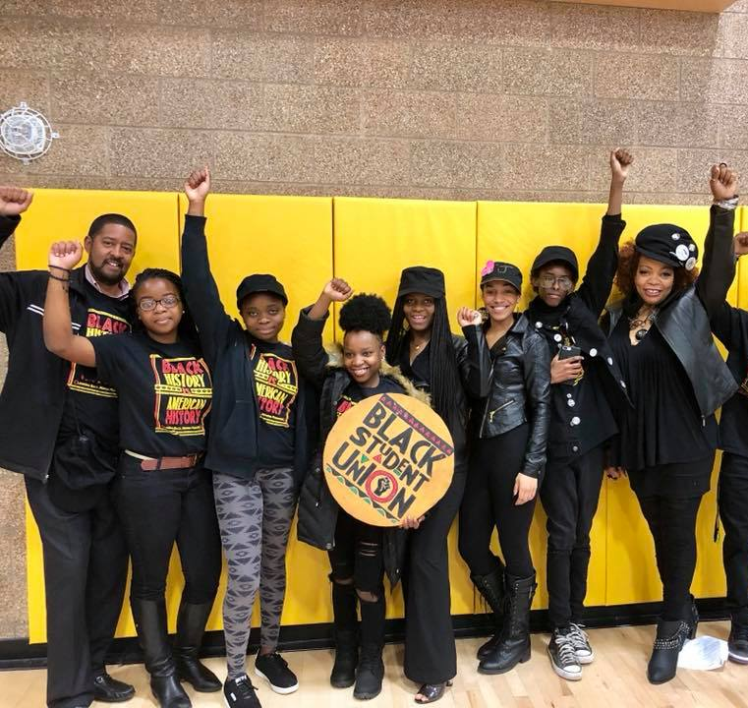
Becoming a teacher helped me define my purpose
I am rooted in offering culturally empowering healing-centered programming because...
when I became the only Black teacher at Oregon’s most diverse high school, I saw a similar woundedness in other Black youth that I had experienced during a lifetime of enduring racial oppression & other forms of crippling trauma.

Slide 6
Founded I Am MORE.
Then, in pursuit of my Doctor of Education degree, I discovered....
Black youth Are
THE most prodigiously traumatized
Adolescent group

Slide 7
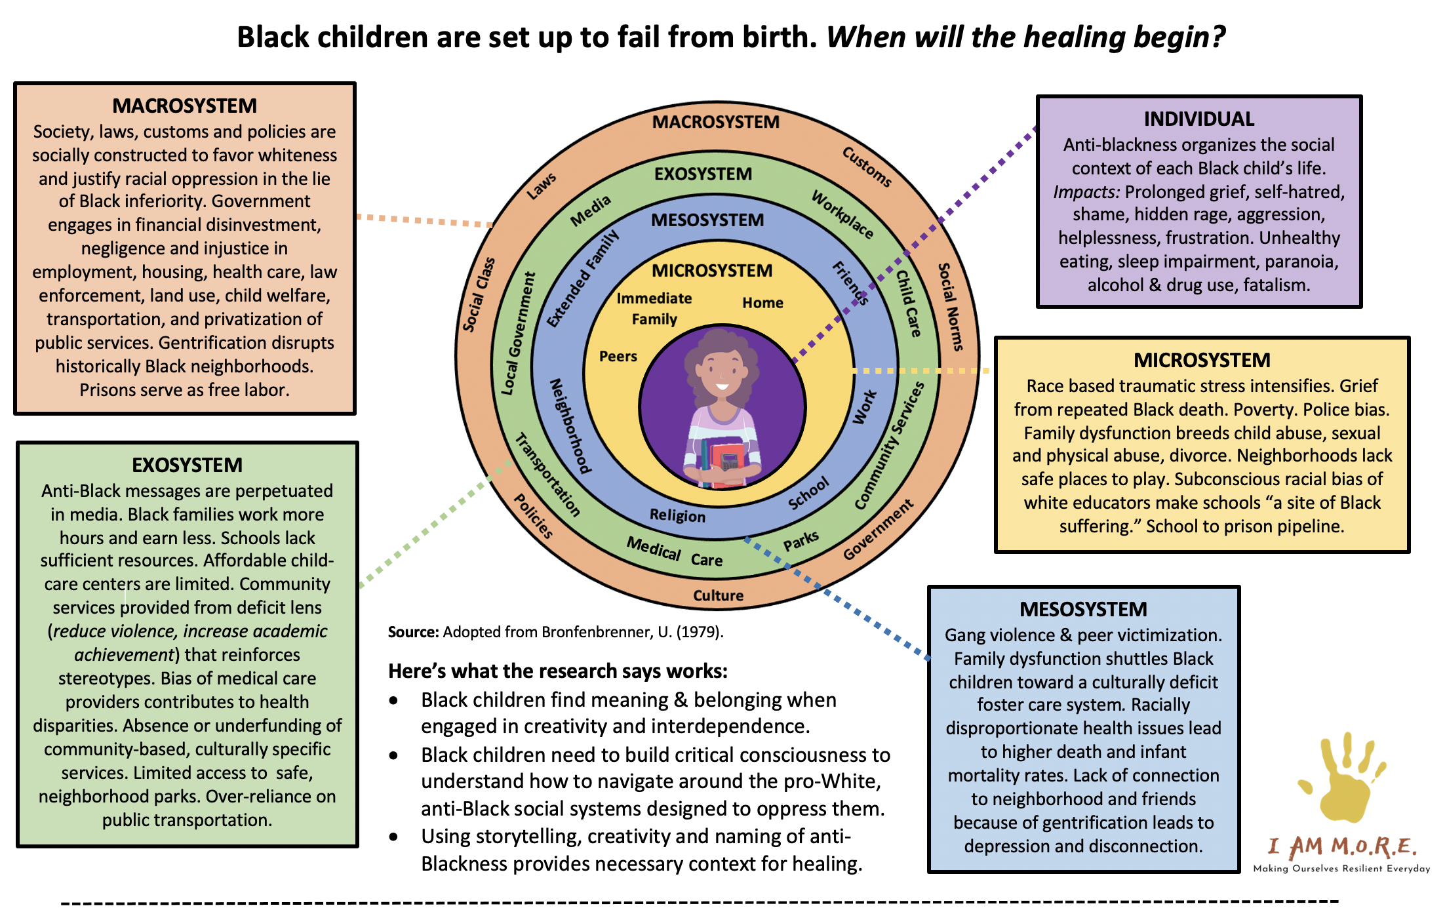
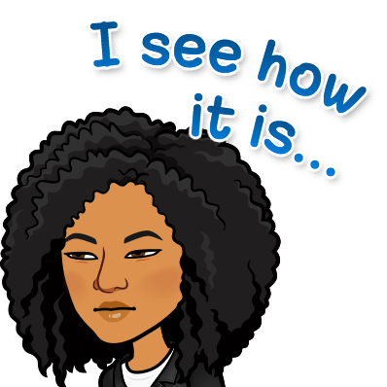
Adapted from Bronfenbrenner, U. (1979).
Sources: Alim & Paris, 2015; Assari et al., 2017; Bennett et al., 2004; Brody et al., 2014; Carter et al., 2005; Coles, 2020; Comas- Díaz; Davis, 2008; DeGruy, 2017; Dumas, 2014; Evans, 2004; Hall & Neville, 2019; French et al., 2020; Ginwright & Cammarota, 2009; Gym 1994; Grills et al., 2016; Grinage, 2019; Gump, 2010; Hardy, 2013; Hyland, 2015; Jackson et al., 2010; Johnson et al., 2019; Kaholokula, 2016; Ladson-Billings, 1992; Legette et al., 2020; Love, 2019; Masten, 2014; Paris & Alim, 2017; Reuf & Fletcher, 2004; Roediger, 1994; Rucker et al., 2010; Shonkoff et al., 2012; Tatum, 2003; Williams et al., 2019; and Wilson, 2002.

Slide 8
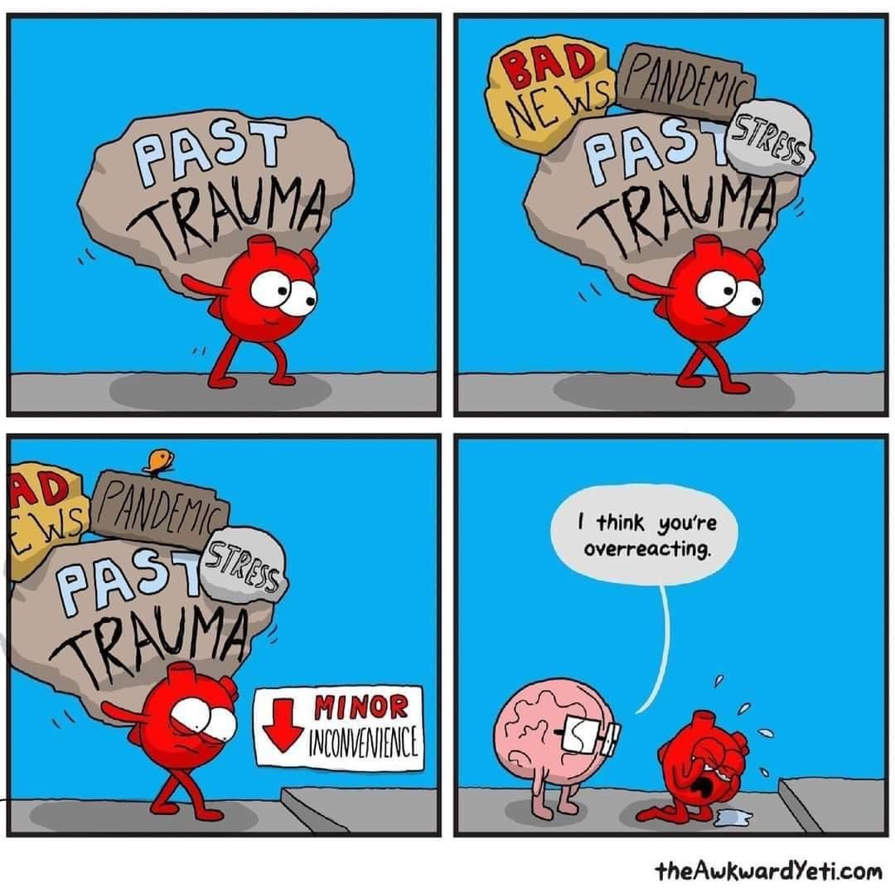
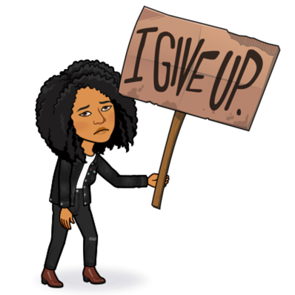
Too often, schools, society, and even parents blame
the victims...

Slide 9
Black youth
don’t need more discipline, a basketball, or
outside approval
to get their lives
on track...
They need

Slide 10
Trifecta Seal of Scholarly Approval
Our foundation is rooted in:
Research
Theory
Evidence
PLUS, cultural norms
This is the foundation of the inaugural Black Youth Leadership Initiative

Slide 11
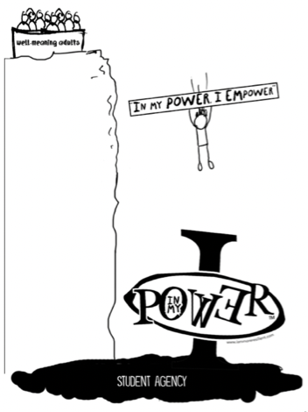
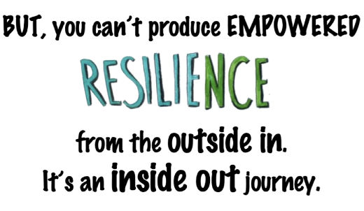

Slide 12
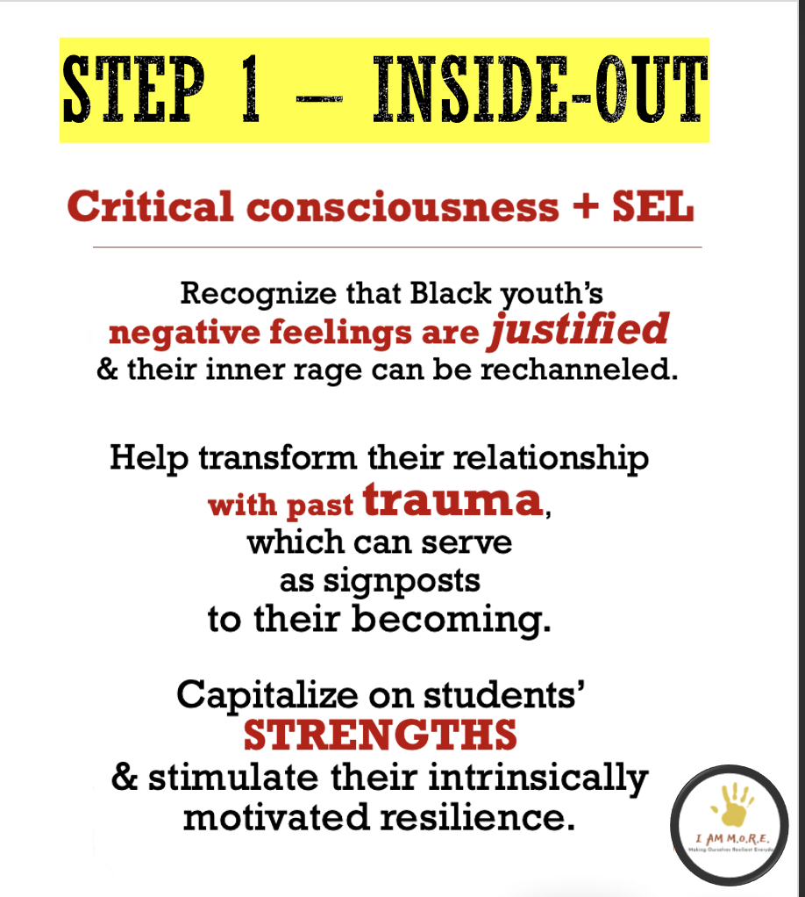
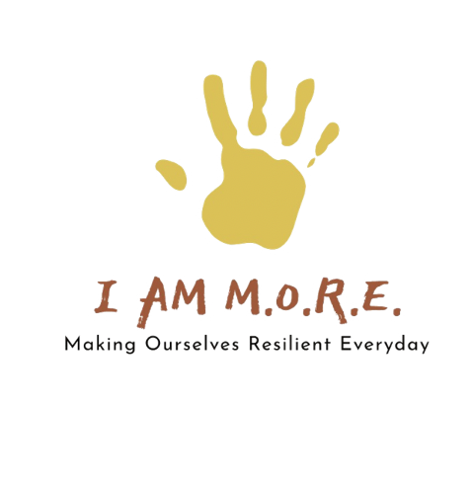
Step 1 – Inside-out
Step 1 – Inside-out
Step 1 – Inside-out

Slide 15
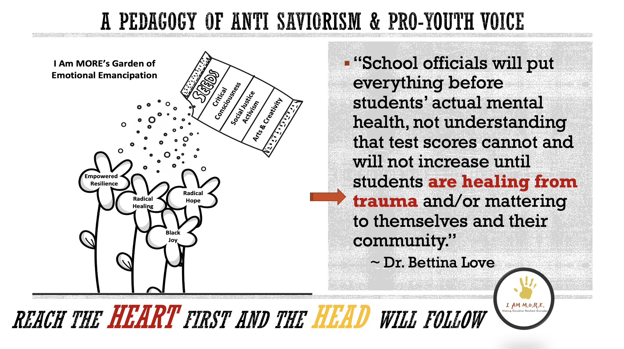
Adults in I Am MORE serve as Master Gardeners…

Slide 17
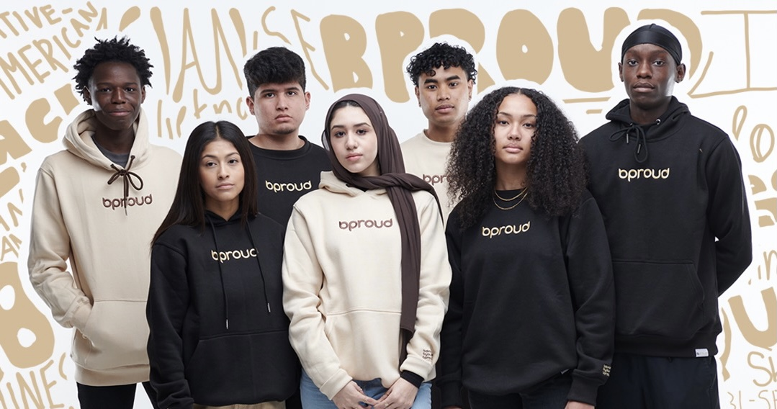
https://bproud.shop
Then, when youth are empowered, they are inspired to look for ways to empower others!

Slide 18
WHAT is DIFFERENT?
Focus on Healing & Self-love
Entrepreneurship
Service learning
VIBE-In Collective
Publishing & Consulting
Youth evaluators
Black Community space
Black elder mentorship

