Slide 1
2017-2020 Area Plan
Public Hearings
Multnomah County Board Room
Aug. 23, 2016
Sharron Kelley Room
Aug. 24, 2016
Rebecca Miller, MPA, Planning & Development Specialist
Aging, Disability, & Veterans Services Division (ADVSD)

Slide 2
Overview of ADVSD
Area Agency on Aging - Serving Multnomah County
Division of County Human Services
Three Advisory Councils:
Senior Advisory Council (Elders in Action Commission)
Disability Services Advisory Council
Multicultural Action Committee
Fund Sources:
Federal (Title XIX, OAA, USDA)
State (OPI)
Local (County, Cities)

Slide 3
Area Agency on Aging
Core Services
Information & Assistance (ADRC)
Access to Public Benefits (SNAP, Medicaid)
Medicare Counseling
Case Management & Options Counseling
Transportation & Coordination
Nutrition Services (congregate & home-delivered meals
Health Promotion & Disease Prevention
Family Caregiver Support
Legal Services
Elder Abuse Prevention

Slide 4
Other Programs and Services
Long Term Services & Supports Case Management and Eligibility Determination
Adult Protective Services
Adult Care Home Program
Public Guardian & Conservator

Slide 5
Serving the County
N/NE– Hollywood Senior Center (Urban League)
East– YWCA/Impact NW
Mid – IRCO
Southeast– Impact NW
West – Neighborhood House (Elm Court & Friendly House)
Five Regional Branch Offices (W, N/NE, SE, Mid, E)
Urban League of Portland (NE Multicultural SC)
African American Health Coalition (Charles Jordan & Dishman)
Asian Health & Service Center
El Programa Hispano Católico
NAYA Family Center
SAGE Metro Portland/Friendly House

Slide 6
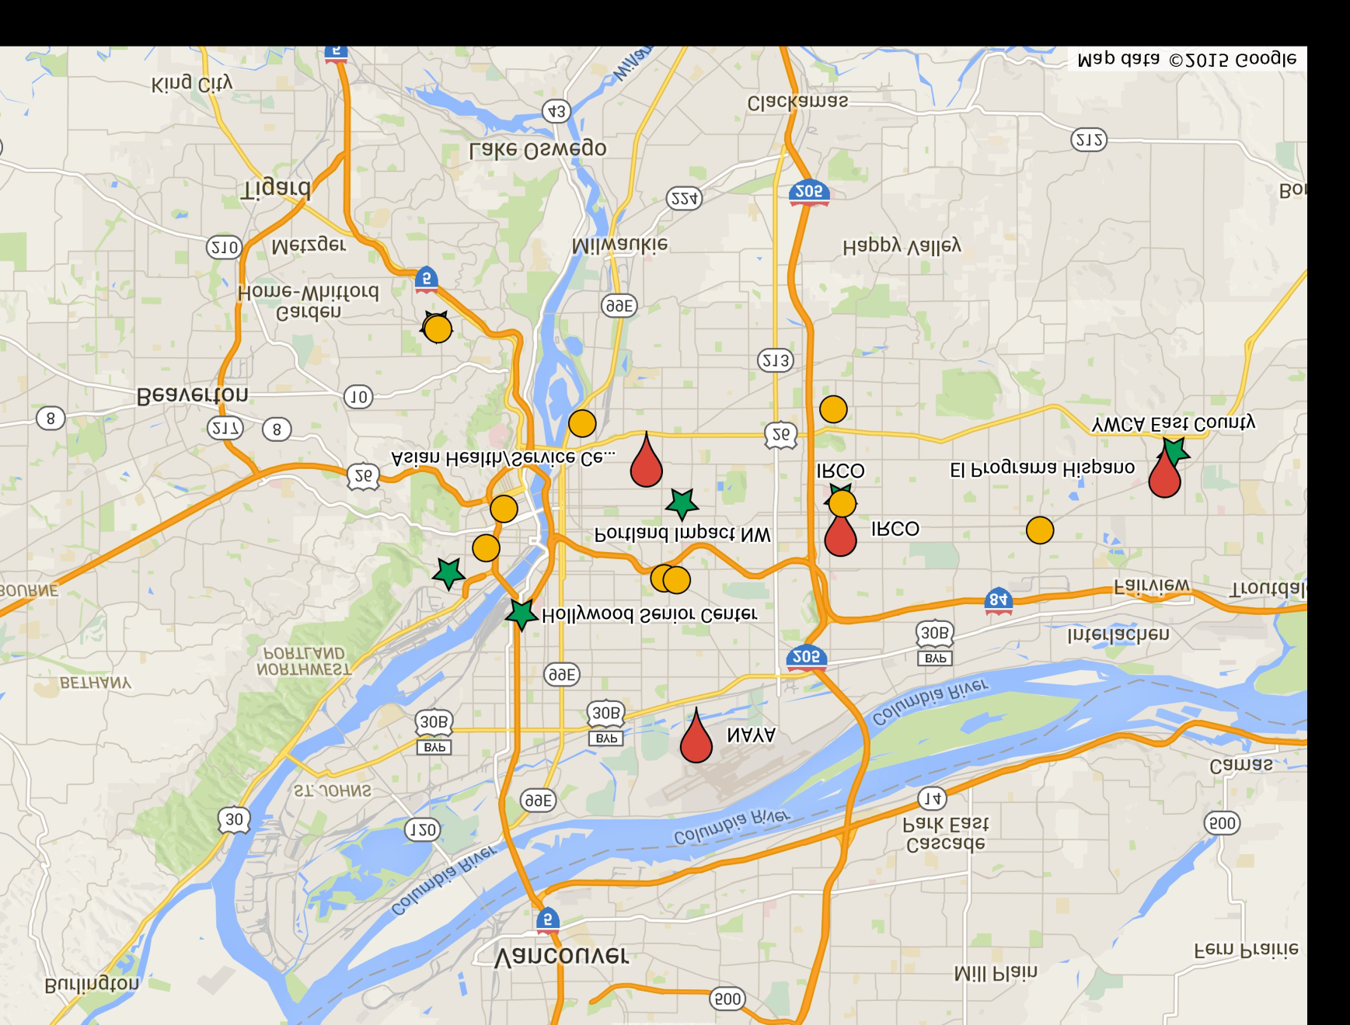



Senior Nutrition Sites
Culturally-specific meal sites
District Center-based meal sites
MOWP

Slide 7
2014 Population Profile
Group | Population | Population %
Total | 140, 097 | 100%
Below 185% FPL | 59, 435 | 7.6%
Minority | 23, 676 | 16.9%
Person with Disability | 39, 409 | 28.1%
Limited English Prof. | 12, 048 | 8.6%
American Indian or Alaska Native |  | 0.6%
Black/African-American | 7, 024 | 5%
Asian/Pacific Islander | 9, 962 | 7.1%
Other Race | 1, 326 | 0.9%
Two or More Races | 1, 871 | 1.3%
Hispanic | 4, 070 | 2.9%

Slide 8
People with Disabilities (18-59)
Notes:
Source: PSU Population projection 2010
Description: The above graphic shows geographic hotspots by census tract for disabled persons between the ages of 18 and 59, analysis uses natural breaks to determine brackets.

Slide 9
People with Disabilities(60+)
Notes:
Source: PSU Population projection 2010
Description: The above graphic shows geographic hotspots by census tract for disabled persons over the age of 65, analysis uses natural breaks to determine brackets.

Slide 10
10
Notes:
Age 60 and above population distribution

Slide 11

About the Area Plan
Area Agency on Aging (AAA)requirement
Comprehensive and coordinated service delivery system
Online at www.multco.us/ads
Updated annually

Slide 12
Issue Areas
Family Caregivers
Information & Assistance (I&A) and Aging & Disability Resource Connection (ADRC)
Elder Rights & Legal Assistance
Health Promotion
Older Native Americans
Nutrition Services
Additional – determined by community feedback

Slide 13
The Planning Process
Information and data gathering
  Consumer Satisfaction Survey
  ADRC – reports, unmet needs
  18 Community Listening Sessions
  Focus Area Integration Workgroup
Resources
  2014 (5-year estimate) – U.S. Census
  “Communities of Color in Multnomah County: An Unsettling Profile” – Population Specific
  PSU Population Projections
  Multnomah County Age-Friendly Action Plan & supporting documents

Slide 14
Targeted Outreach
African American
LGBT
Latino/Hispanic
Asian American
Immigrant/Refugee
People with Disabilities
Family Caregivers
Resident Communities
Native American
Gresham Mid County Downtown North/NE

Slide 15
Community Listening Sessions
18 community listening sessions
April-June
< 500 people
12 languages
40+ volunteers & staff

Slide 17
Focus Areas
Outreach, Information &Referral
Nutrition Services
Promoting Health
OAA Case Management, Options Counseling
Emergency services/gap programs
Caregiver Support & Education
Safety & Abuse Prevention
Older Adult Behavioral Health
Transportation Coordination & Resources

Slide 18
Community Listening Session Format
Three questions asked:
    What's important to you about this focus area?
    What’s working well for you in this focus area?
    What do you need more of in this focus area?

Slide 19
Information & Assistance Services and Aging & Disability Resource Connection (ADRC)
Decrease isolation and barriers to access experienced by physically, emotionally, culturally, or linguistically isolated older adults.
ADRC is recognized by the community as a valuable resource for older adults and people with disabilities.

Slide 20

Nutrition Services Goals
Older adults will have ready access to healthy food that is affordable and supports a healthy diet.
Be a leader in equity around food security.

Slide 21
Health Promotion Goals
Improve county-wide access to and utilization of services by racial, ethnic, and cultural minorities and other underserved groups of elders that addresses the social determinants of health and/or forge links between health systems and community services.
Involvement in health promotion programs will reduce social isolation by providing older adults and people with disabilities support through social networks and direct linkages to community resources offered by our contracted partners.

Slide 22
Family Caregivers Goals
Support quality services for family caregivers.
Promote access to family caregiver services and resources, including respite services, to meet the needs and preferences of family and informal caregivers from diverse cultural backgrounds.

Slide 23
Elders Rights & Legal Assistance Goals
Ensure that older adults and people with disabilities have access to protection against abuse, financial exploitation, and neglect, with particular attention focused on resources, access and financial stability.
Ensure adequate and equitable access to legal support, peer support, and advocacy for older adults.

Slide 24
Older Native American Goals
Increase accessibility to culturally specific services and support the needs identified by Native American elders.
Enhance services for urban Native American elders by promoting capacity-building in agencies that serve them.

Slide 25
Health System Transformation Goals
Improve coordination of care, enhance member engagement in care coordination, improve coordination of transitions across settings, and improve cross-system education related to older adults and adults with disabilities.

Slide 26
Older Adult Behavioral Health Goals
People who need services know where to go and feel comfortable seeking out services.
Develop a system that provides services and supports to people with multiple needs who do not fit into one system.

Slide 27
Veterans Goals
Older adults leverage entitlements to benefits through the federal Veterans Administration, as well as state and county resources to meet and maintain their individualized care needs.

Slide 28
Goals of the Public Hearings
To show the public the ADVSD plans from 2017-2020 for Older Americans Act services and programs.
To listen to the public and incorporate public input about what can be improved about the plan, particularly from people who are most impacted by it.
To be transparent about the steps taken to develop the plan and address any concerns about the voices represented in the plan.
To fulfill the State Unit on Aging requirement for a public hearing.

Slide 29
Share Your Opinion with ADVSD
Public Testimony: Sign-up in back, 2 minutes per person
OR
Email: areaplan@multco.us
Call: (503)988-3646
Write: Area Plan; Multnomah County ADVSD 421 SW Oak Street, Suite 510, Portland, Oregon, 97204-1817
Deadline: September 13, 2016
  Updated annually

Slide 30
Questions?
Aging, Disability, & Veterans Services Division

