Slide 1
Homework Club
Rachel Elder

Slide 2
Set Students Up for Success
Small Groups
Ratio of 1:15 for older students
Ratio of 1:10 for younger students
Classroom Setting is Best
Not Cafeteria if you can avoid it!
Silent, Individual Work Environment
Notes:
Tried using cafeteria for all students my first year, major failure
Even having 1 group in the café is too noisy
If students have a question, they need to raise their hand

Slide 3
Every Student, 30 Minutes
Work on assigned homework
Read silently
Extra homework available
Notes:
Before students leave the café instructors make sure everyone has something to do in HW Club.
If a student isn’t working, I/instructors ask them what they should be doing and make them list all their options.
Older kids can get assignments for themselves, younger kids extra assignments are on hand.
“I’ve finished” isn’t a choice
Coloring or drawing isn’t a choice unless it’s a homework assignment (explain why)

Slide 4
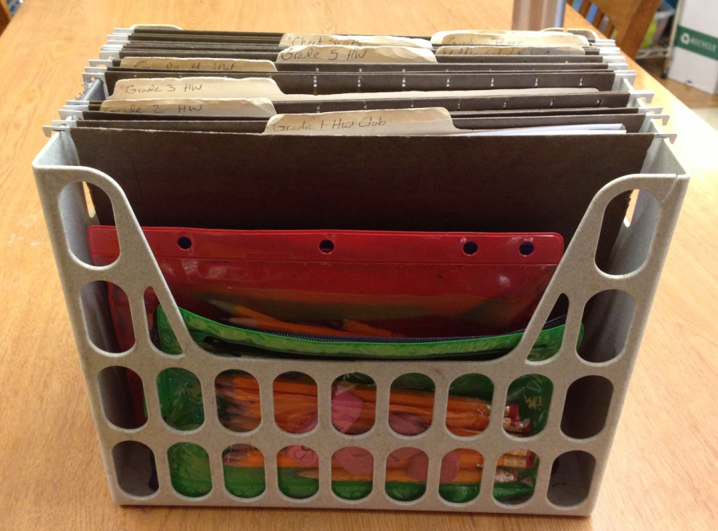
Have the Right Tools
Homework Club Basket
Sharpened pencils with extra erasers
Blank paper
Extra assignments
Calculators available for check-out when appropriate
Dictionaries
Notes:
Basket kept in cafeteria after school.
Every instructor grabs a pouch of pencils and has extra assignments for each grade level on hand
Don’t provide silent reading books – kids spend too much time trying to choose a book, books get trashed, too much to keep track of. HW bin is small and easy.
Edhelper.com - $30 for 1 year subscription, or ask teachers at school for books with worksheets, or some worksheets available free on internet.

Slide 5
Consequences 3rd grade and Up
A student gets 1 warning for talking or being off task.
Second warning and the student’s seat is moved.
Third warning, they start “making up” time after HW Club ends.

Slide 6
Homework Club for 1st and 2nd Grade
Talk with teachers to see who is assigning homework and how regularly.
Have instructors check students’ backpacks.
Have kids sit together who are working on the same assignment.
Extra assignments for this group is a MUST!
Incentives for those that are “on task.”
Notes:
This age group is the most difficult when it comes to homework club!
At Peninsula, many teachers in this group assign weekly packets. Get extra copies each week.
Students often don’t even know if they have homework.
This group will need the most individualized attention – can’t read directions on HW.
Many times students won’t have homework, so I do handwriting sheets and counting math worksheets for first grade, and age appropriate math for the 2nd graders.
Instructors give out stickers to students who are on task – this looks very different for this age group. Could mean staying in seat the whole time, depends on student.
Consequences: these students can be given warnings and moved, making up time won’t work – just lose their sticker.

Slide 7
Middle School Homework Club Agreement
Homework Club Agreement
Student Name: ___________________
This agreement is to explain the expectations for students and staff during Homework Club.
Staff Expectations:
Help students with their homework during Homework Club but not give students the answers
Encourage students to do their best work possible
Make Homework Club a positive learning environment
Student Expectations:
Come prepared to Homework Club with something to do the entire time
Be on task during Homework Club
Do your own work during Homework Club; copying work WILL NOT be tolerated!
Stay seated during Homework Club; if you need assistance please raise your hand
Keep your hands to yourself
Consequences for Not Following Expectations
If a student does not have something to work on or finishes their work early, Homework Club staff will assign work for the rest of the Homework Club session
If a student consistently does not bring work to do or chooses not to do their work, they will write a letter to their parents explaining why they chose not to be prepared for Homework Club
If a student is continually disruptive or choose not to follow rules, that student will make up missed Homework Club time the following day with lunch detention.
If a student breaks their behavior contract, this will result in suspension or expulsion from SUN School
By signing below, I am agreeing to the expectations and consequences for Homework Club.
X____________________________
Student Signature
Notes:
This can work with middle school aged students.
When used, the first day of Homework Club is to go over agreement and expectations.

Slide 8
Setting Up Expectations
Language in Activity Guide
“Academic Skill-building, Homework Assistance will be taking place Mon-Thurs, 2:35
3:05 for all students. Students are expected to bring something to work on for the
entire 30 minutes! If your student does not have something to work on during this
time, s/he will complete academic activities SUN School has on hand.”
Notes:
Blurb that is in every Activity Guide, so students and parents are aware of Homework Club.

Slide 9
Setting Up Expectations
Language on SUN Confirmation Letter
Monday / Lunes: 2:35-3:05 4/8/13-5/20/13
____Homework Club Bring your homework or a book every time.
Monday / Lunes: 3:05-4:00 4/8/13-5/20/13
____Imagine Learning ESL
____Dollars and Sense
____ Ballet (2 hours)
____Junk To Funk
____ Playworks
Notes:
Homework Club is considered one of the “Classes” kids take at SUN School, just like Playworks or Ballet.

Slide 10
Common Problems
Frequent Bathroom Trips
Middle school aged students needing to go to lockers
Younger students – homework left in classroom
Not getting homework done!
Notes:
Bathroom pass, letting kids go one at a time. Could take whole group to bathroom and start 30 minutes of HW when everyone is settled in class.
One “get out of jail free” card, after that, get an assignment from the bin. Another good reason to check in with students during supper about what they have for homework.
Students who are “on task,” silent reading or doing SUN School HW, but not getting classroom HW done.

